Slide 1
CHILDHOOD OBESITY
Physical and Emotional Ramifications
Written by: Renae Buss

Slide 2
Participant Outcomes:
1. Recognize two needs:
  Less talk, more action!
  One resource teaching both physical and nutrition education.
2. Become a leader to decrease childhood obesity,
improve children’s wellness, and optimize academics.
3. Re-examine the Local School Wellness Policy.
4. Receive information on an innovative fitness program
for kids—the bSAFE bFIT! Program for kids.
5. Walk away with ready-to-use learning strategies that
excite children to be physically active while engaged in
physical and nutrition education; linking schools, families,
and the community.

Slide 3
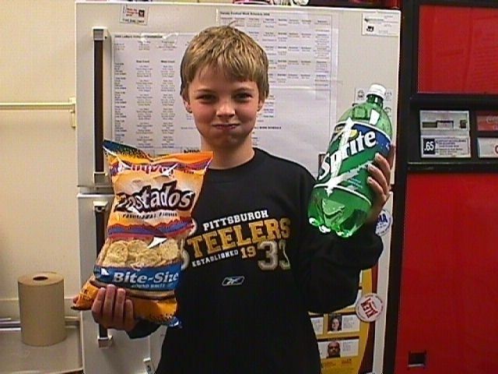
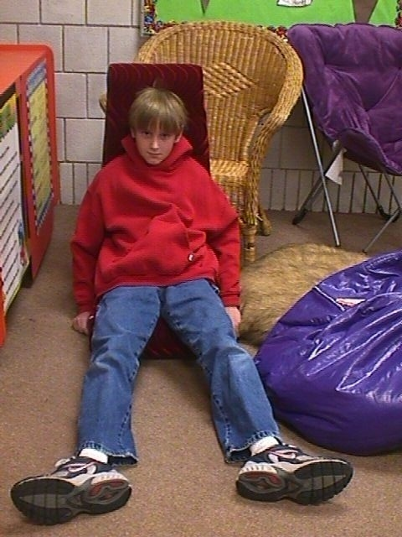
KEY CULPRITS
  Poor nutrition Lack of physical
  activity

Slide 4

ONE RESOURCE
TEACHING BOTH
PHYSICAL and NUTRITION Education

Slide 5
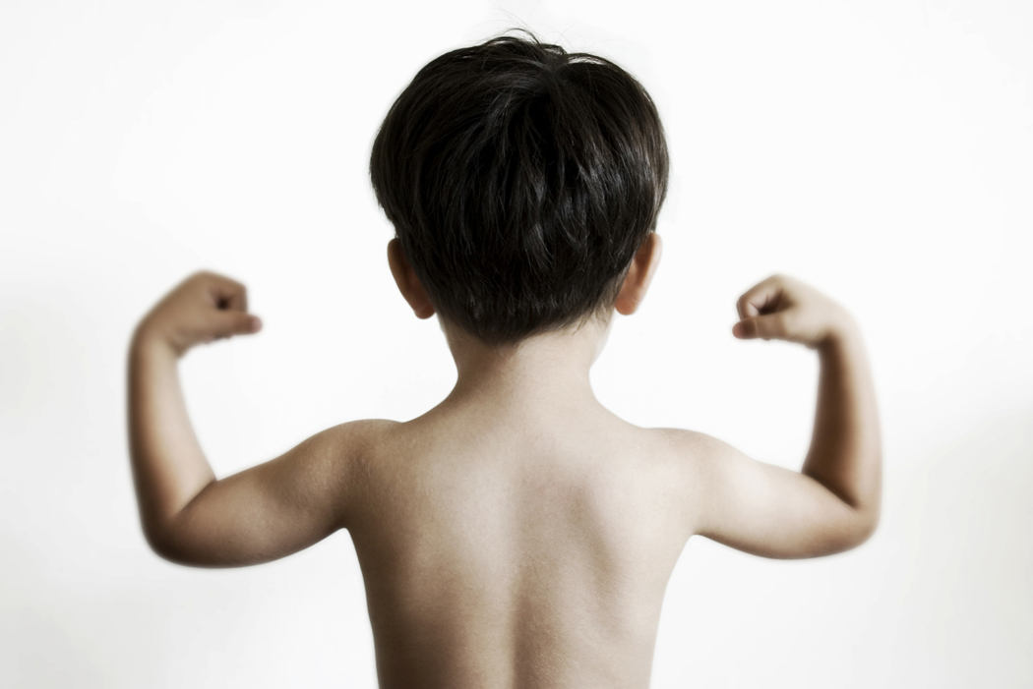
EARLY EDUCATION

Slide 6

LINK TO ACADEMICS
Physical Activity Healthy Eating

Slide 7
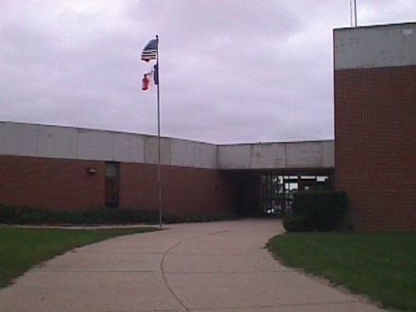
AVENUES
School
Family
Community

Slide 8
LOCAL WELLNESS POLICY
The Child Nutrition and WIC Reauthorization Act
Required for schools participating in the National School Lunch Program
Section 204 addresses Physical Activity and Nutrition education

Slide 9

LESS TALK
MORE ACTION
Only words without action!

Slide 10
PHYSICAL EDUCATOR
LEADERSHIP ROLE

Slide 11


TWO RESEARCHED-BASED
RESOURCES COMBINED
National Association for Sport and Physical Education (NASPE)
United States Department of Agriculture MyPyramid for kids (USDA)
ONE RESOURCE
TEACHING BOTH PHYSICAL AND
NUTRITION EDUCATION

Slide 12
EASY TO IMPLEMENT LESSONS
Excite children to be physically active
Engage in physical and nutrition education
Link schools, families, and the community

Slide 13

CHILDREN MOVING
WHILE LEARNING!
EDUCATORS MEETING
SCHOOL WELLNESS
POLICIES!

Slide 14
CONCERN FOR TIME
Short and to the point
Lessons completed in 5 to 10 minutes
Beginning or end of day, during
an activity break, after school
programs, etc.

Slide 15

UNIQUE STRATEGY
bSAFE bFIT! Program
for kids

Slide 16
FITNESS PALS
WATERMELON JACK
Physical Activity
Jumping Jack
Food Group
Fruits
WATERMELON JACK! (Fruits, Aerobic Fitness)
Wow! Stand with your feet together and arms down at your sides. Jump, spread your feet apart, and lift your arms above your head. Return to how you started. Repeat in rhythmic motion!

Slide 17
“bSAFE”
Five components of health-related physical fitness
b “b”ody Composition
S “S”trength
A “A”erobic Fitness
F “F”lexibility
E “E”ndurance

Slide 18
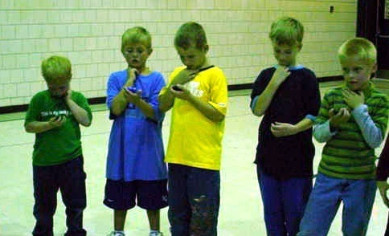
SQUADS—groups of 5
Body Composition Squad
Strength Squad
Aerobic Fitness Squad
Flexibility Squad
Endurance Squad
Grains Squad
Vegetables Squad
Fruits Squad
Milk Squad
Meat & Beans Squad

Slide 19
CONTENT STANDARDS
BASED ON:
National Standards for Physical Education
National Health Education Standards

Slide 20
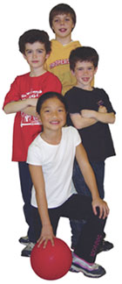
bSAFE bFIT!
Educational Tools
Manual with Lesson Plans
Posters—five 18 x 24”
Activity Cards—55
CD—10 songs
Instructor DVD

Slide 21
bSAFE bFIT! MANUAL with LESSON PLANS
For you—sample lesson
1. Lesson 5
2. Lesson 22

Slide 22
bSAFE bFIT! MANUAL MAIN CONCEPTS
Body shapes and sizes
PEDIATRICIAN IS THE BEST PERSON TO TALK TO ABOUT A HEALTHY BODY
Calorie Needs and Expenditures
Children 2-3 1000 1000-1400
Children 4-8 1200-1400 1400-1800
Girls 9-13 1600 1600-2000
Boys 9-13 1800 1800-2600
Physical Education—National Association for Sports and Physical Education
Warm up and Cool down
Strength and Endurance
  Seven major muscle groups
  NASPE recommendations of 2 to 3 times a week using own body weight
Aerobic Fitness
  How to take heart rate
  Children’s resting heart rate (also appears on the poster)
Flexibility
  NAPSE recommendations—slow stretching
Nutrition Education—USDA MyPyramid
Food Groups—Grains, Vegetables, Fruit, Milk, Meat and Beans
What foods are in each group(Fruits)
  Apples, oranges, grapes, etc.
USDA recommended daily amounts
  Children 4 to 8 1 to 1 ½ cups
  Girls 9-13 1 ½ cups
  Boys 9-13 1 ½ cups
What counts as an amount
  1 small apple equals 1 cup
  1 cup grapes is equal to 1 cup

Slide 23
FITNESS PAL POSTERS
Visual Learning

Slide 24
FITNESS PAL ACTIVITY CARDS
55 Fitness Pals (5 components, 5 food groups)
              For you:
              Sample Fitness Pal
              Suggestions for bSAFE bFIT! Activity Cards

Slide 25
MOVE N’ WITH FITNESS
PALS CD
10 songs

Slide 26
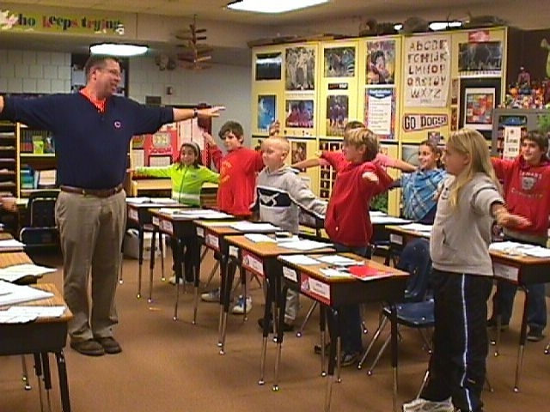
FABULOUS FIT FRIDAY

Slide 27

bSAFE bFIT!
Instructor DVD

Slide 28






ORDER INFORMATION www.strikersportsllc.com
GOPHER
All educational tools range $139 to $179

Slide 29


OTHER REPUTABLE RESOURCES
American Cancer Society (ACS)
Center for Disease
Control and Prevention (CDC)
Caine Learning Institute

Slide 30
NEWLY CREATED LEARNING STRATEGIES
Food Tasting
Comic Strips
Diary of Vegetables and Fruits
Nutrition Facts Food Label
Portion Size versus Serving Size
Spelling Relay
Exercise at the Nursing Home
For you
  Peppers
  Wellness Makes Sense
  Sardine Stroll with Students, Families, and the Community

Slide 31
CROSS CURRICULAR
PHYSICAL EDUCATION MATH
CLASSROOM HEALTH
SCIENCE LITERACY
ART MUSIC
COACHES
COUNSELORS LIBRARIAN
NURSE CAFETERIA STAFF

Slide 32
Elementary WELLNESS Newsletter
Le Mars Community Schools
Physical and Nutrition Education
Linking schools, families, and the community
WELLNESS
Childhood obesity has become a national concern. Overweight children are experiencing physical and emotional physical and emotional ramifications that are affecting
their current and future health. Two key culprits have been identified as to reasons why childhood obesity is on the rise—
PHYSICAL EDUCATION
Years ago, Physical Education was a sports promotion curriculum. However, major changes are erupting to transform the focus to self-improvement rather than being
the best in a sport. My ultimate goal for your child’s experience in Physical Education is that they develop the skills and attitudes to enjoy participating in lifelong
physical activity. In order for your child to adopt a healthy and physically active
NUTRITION EDUCATION
A unique program I am using to implement nutrition education into my existing physical education curriculum
is entitled the bSAFE bFIT! Program for kids. Portions of both the physical and nutrition education curriculums are
We” can make a positive difference in your child’s life when
“we” work together!
Let’s be safe and be fit!

Slide 33
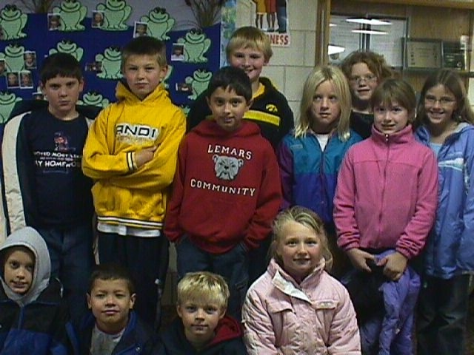
MEANS TO AN END
IMPLEMENTING NUTRITION INTO
PHYSICAL EDCUATION CURRICULUM
Improves children’s:
Fitness levels
Knowledge
Attitudes
habits
bSAFE bFIT! is a perfect fit!
Decreasing Childhood Obesity
      Optimizing Academic

