Slide 1
XaviX: Using Active Technology to Make Fitness Fun!
Donna Moore
2010 Arizona Ambassador for Excellence
Julia Randall Elementary School
donna.moore@pusd.com
Payson, Arizona

Slide 2
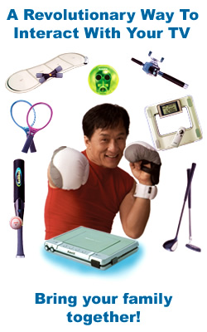
XaviX: What’s That?
Baseball
Bowling
Golf
Power Boxing
Tennis
Jackie Chan Fitness
Music Circuit Workouts
XaviXBassFISHING
Hand-Eye Workout
Life Style Manager

Slide 3
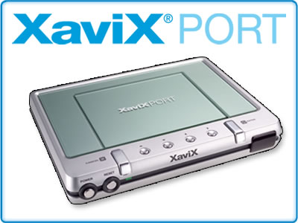
XaviX Improves:
BMR
Coordination
Balance
Weight Goals
Strength
Agility
Cardio
Reflexes

Slide 4

The Simple Joy of Hitting the Ball

Slide 5
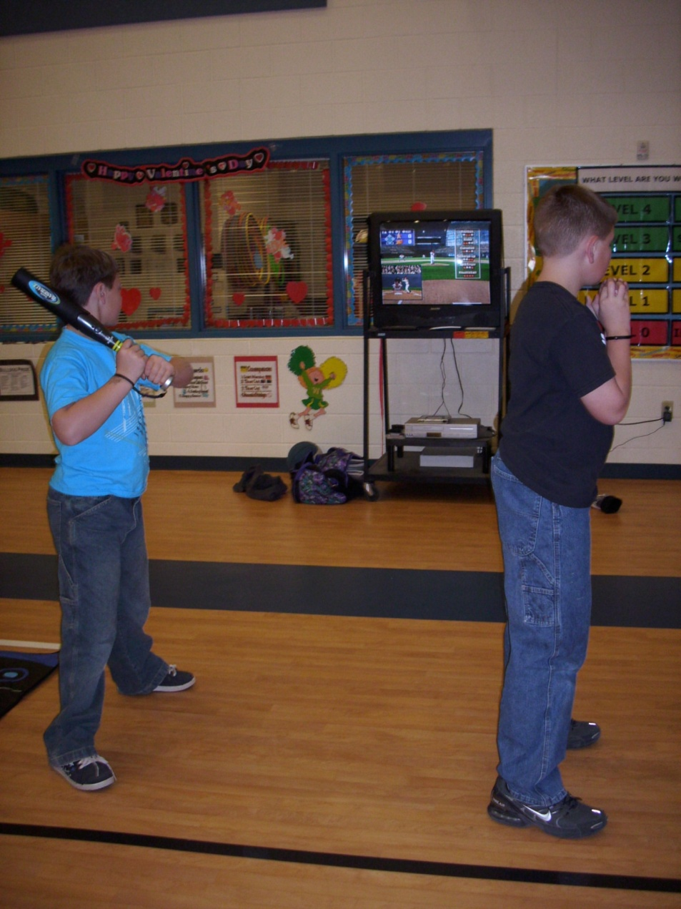
XaviXBASEBALL

Slide 6

The Key Is Timing

Slide 7
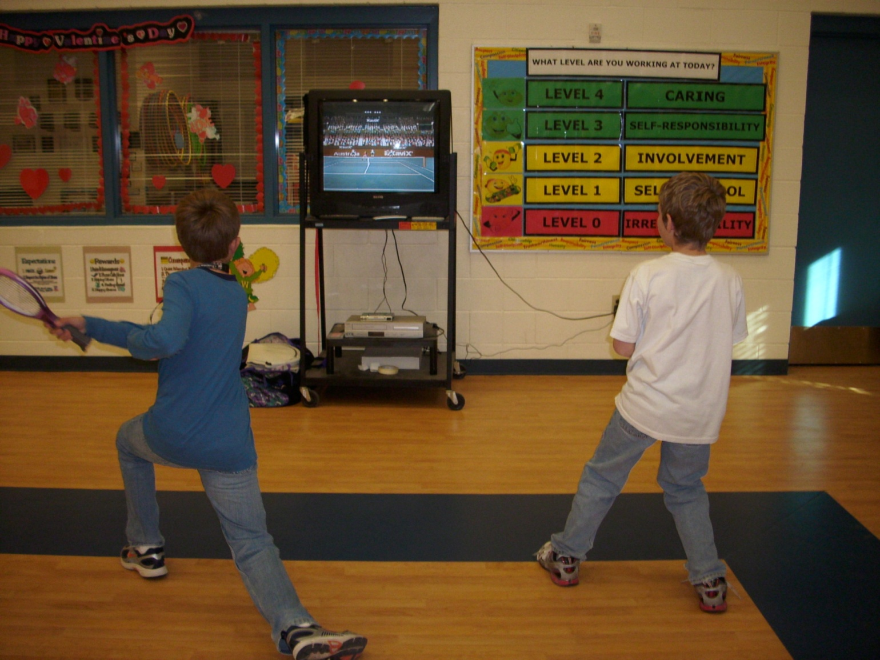
XaviXTENNIS

Slide 8
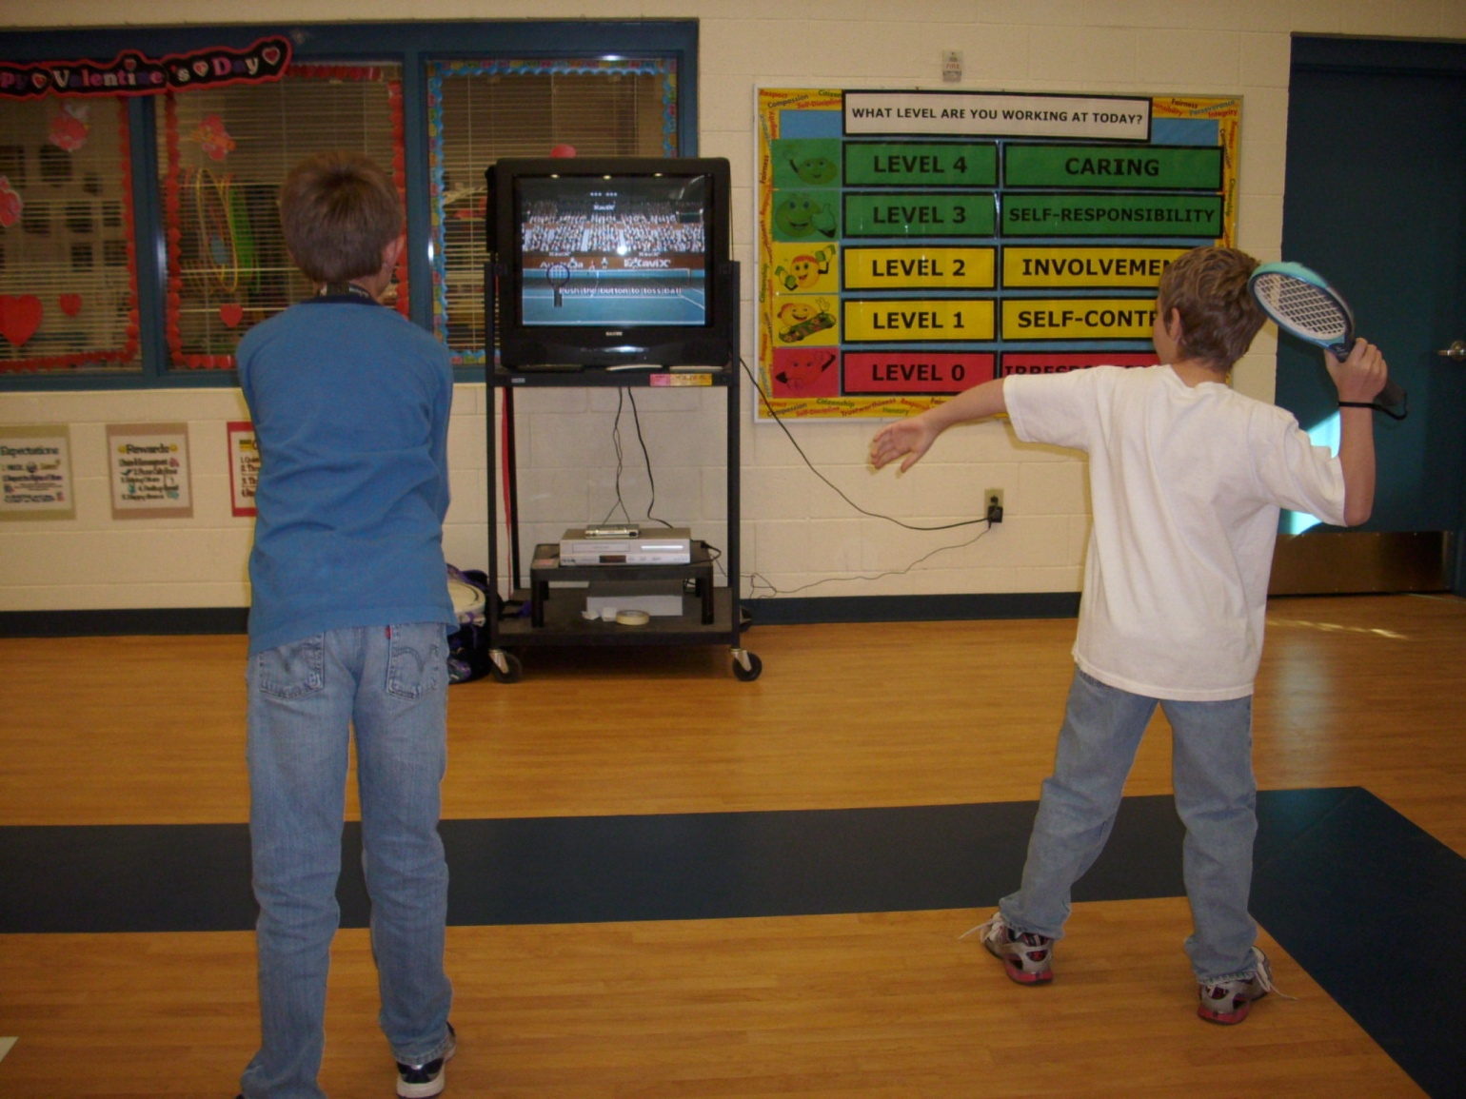
XaviXTENNIS

Slide 9

Speed And Direction For Success

Slide 10
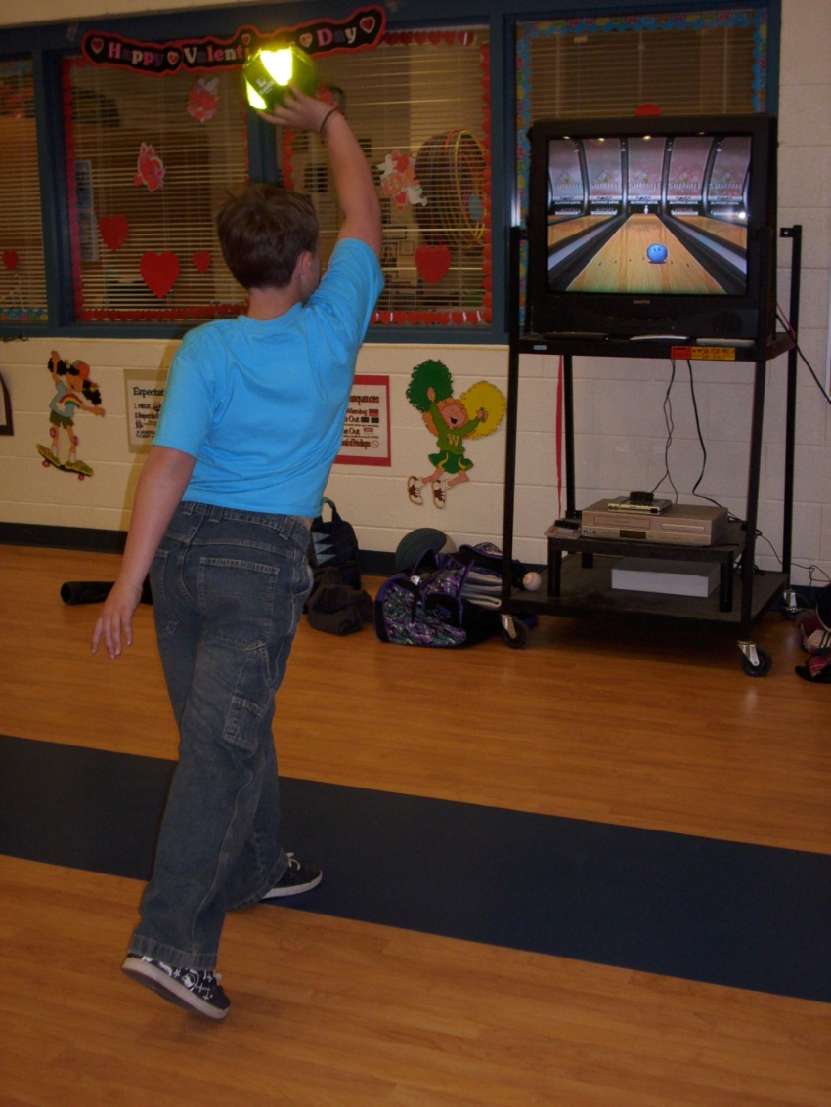
XaviXBOWLING

Slide 11

A Universal Sport

Slide 12
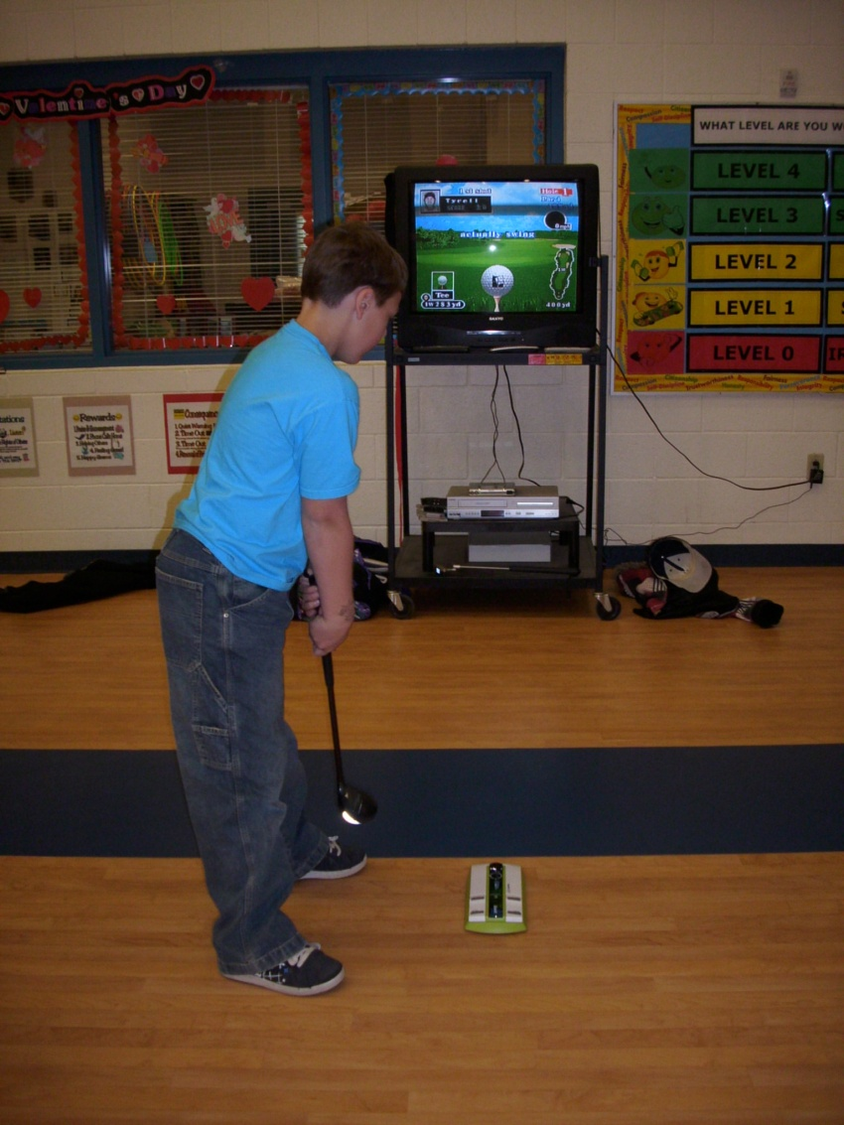
XaviXGOLF

Slide 13
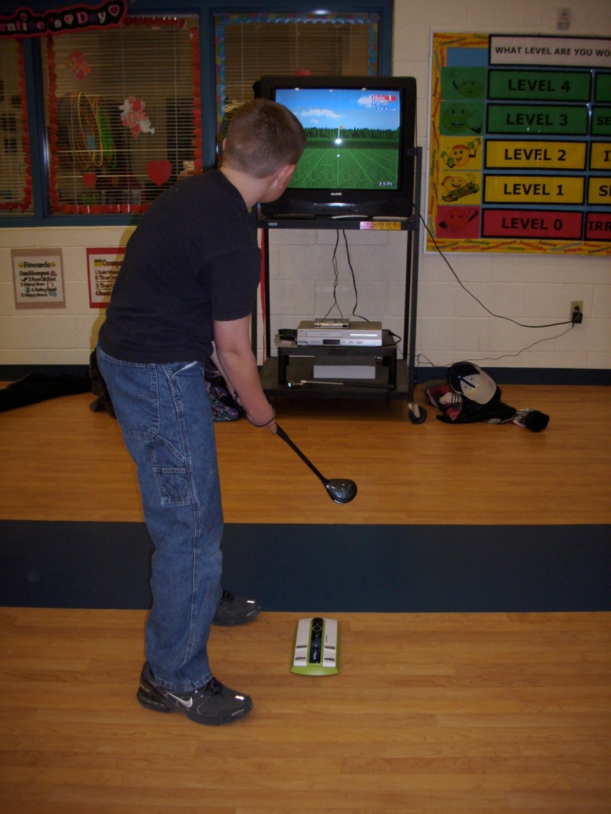
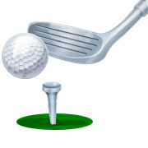
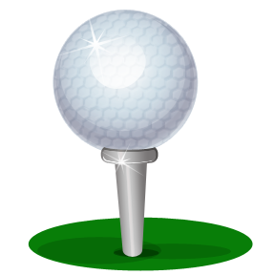
XaviXGolf

Slide 14

Concentration

Slide 15
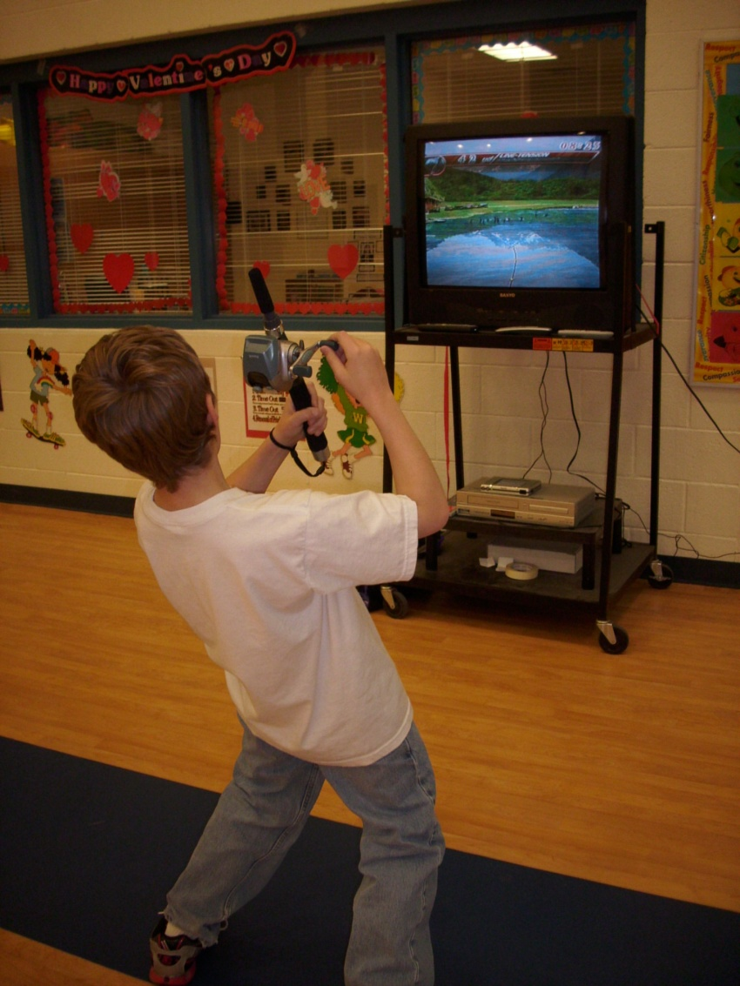
XaviXBassFISHING

Slide 16

You Have The Power To Manage Your Lifestyle

Slide 17
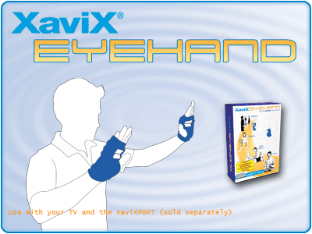
Improve Your Reflexes & Dexterity, Cross Lateral Training, Multi-Task Better

Slide 18

Tone Up With Your Tunes!

Slide 19
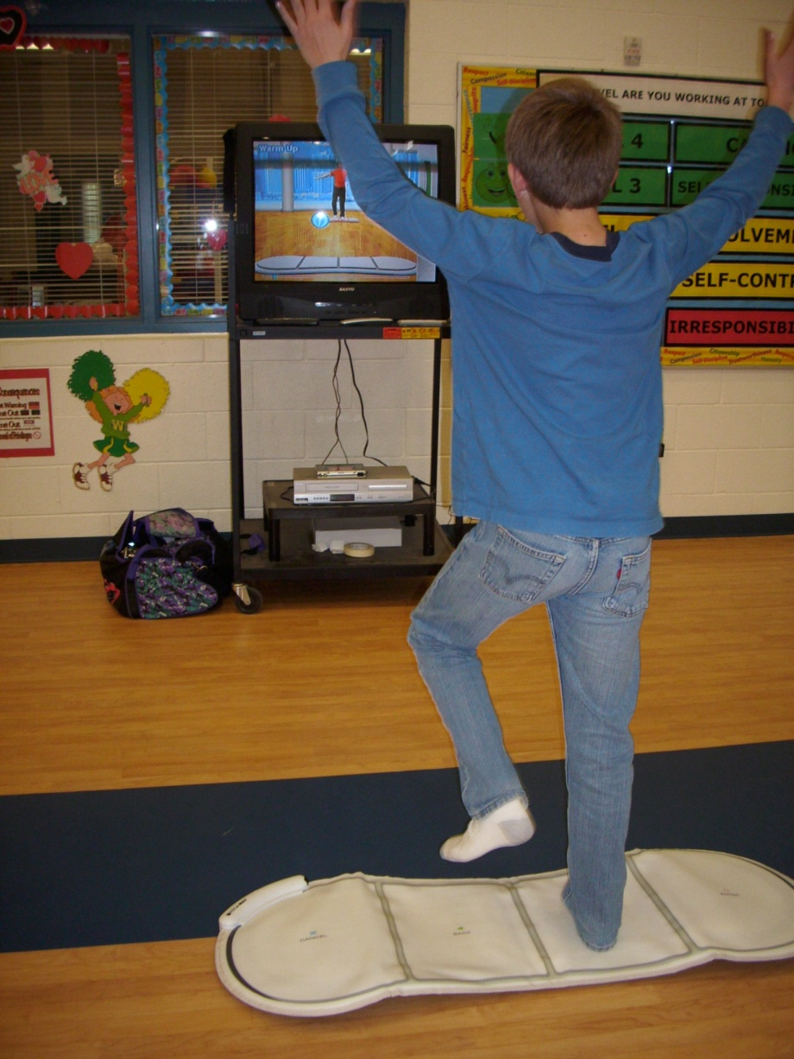
XaviX Music & Circuit

Slide 20

Expert Fitness Choreography

Slide 21
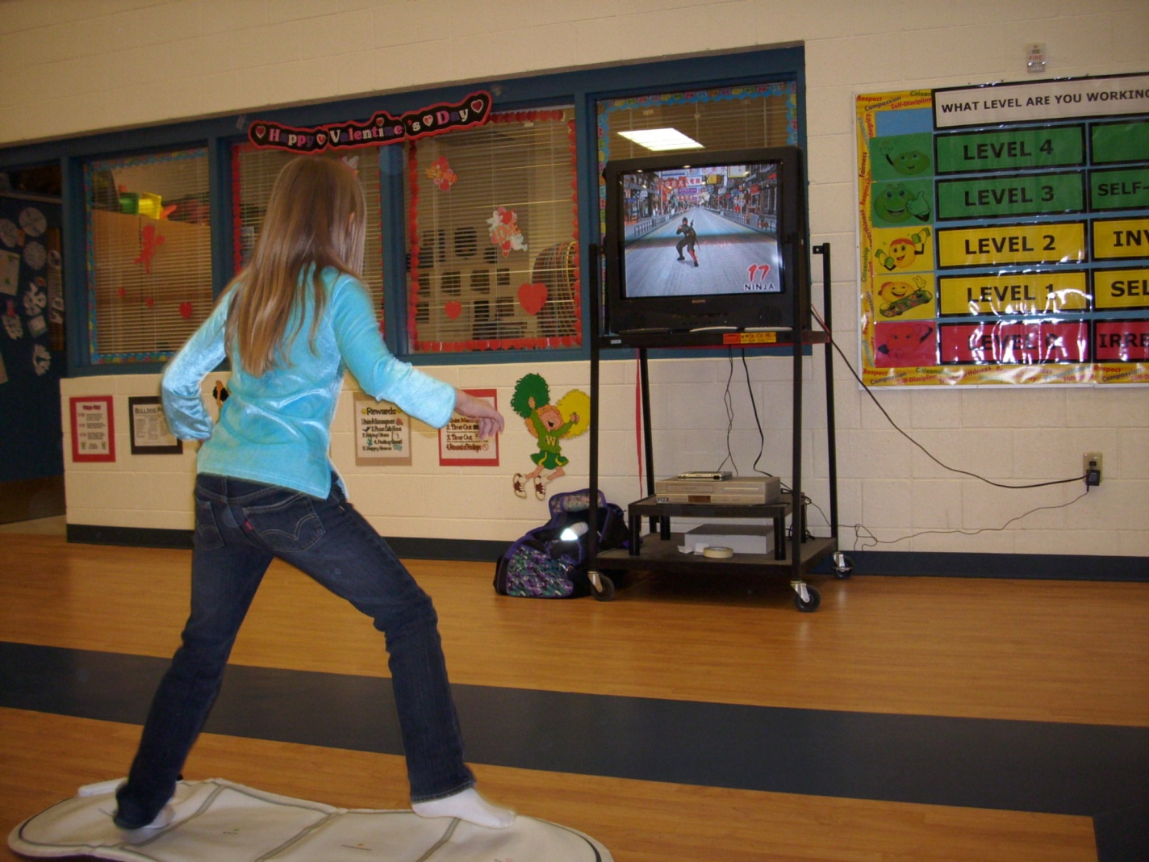
Jackie Chan Studio Fitness

Slide 22
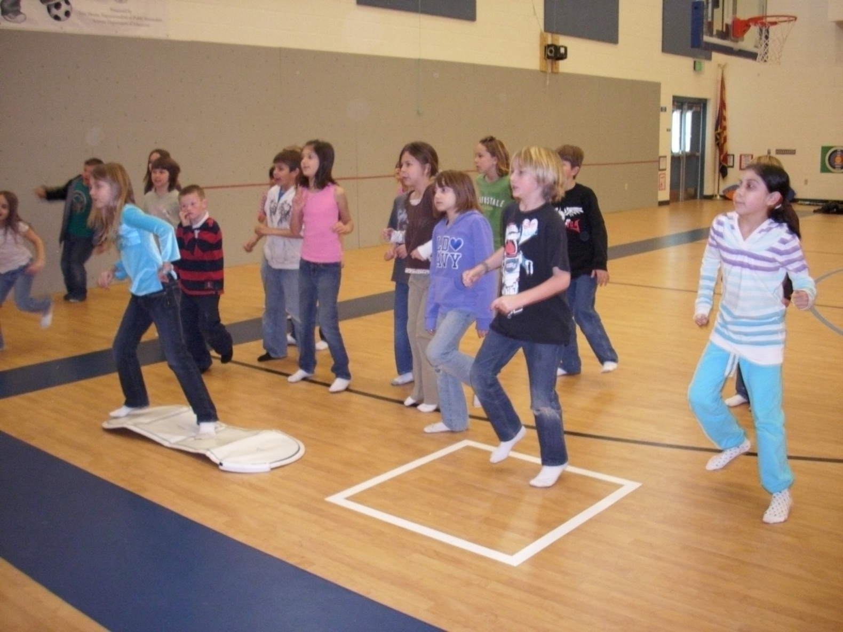
J-MAT

Slide 23

Increase Your Endurance to Go the Distance Workout

Slide 24
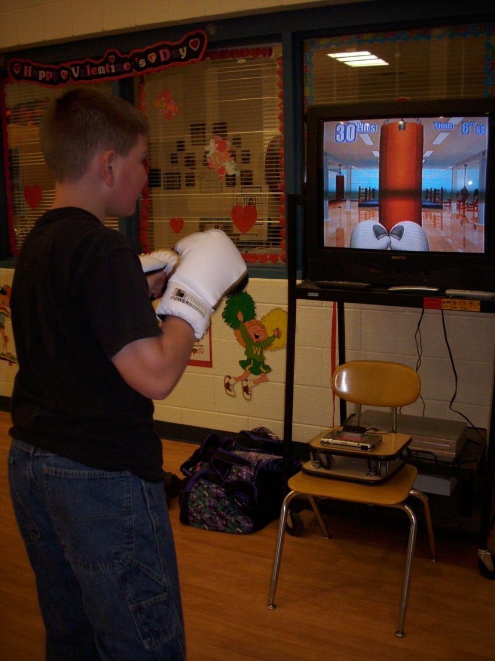
Jackie Chan’s POWERBOXING

Slide 25




OR
COMMENTS

