Slide 1
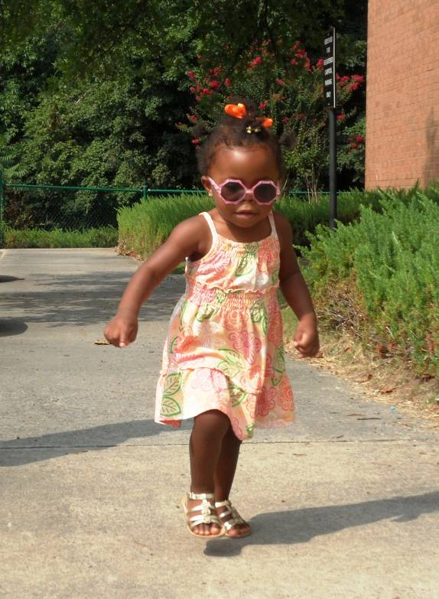
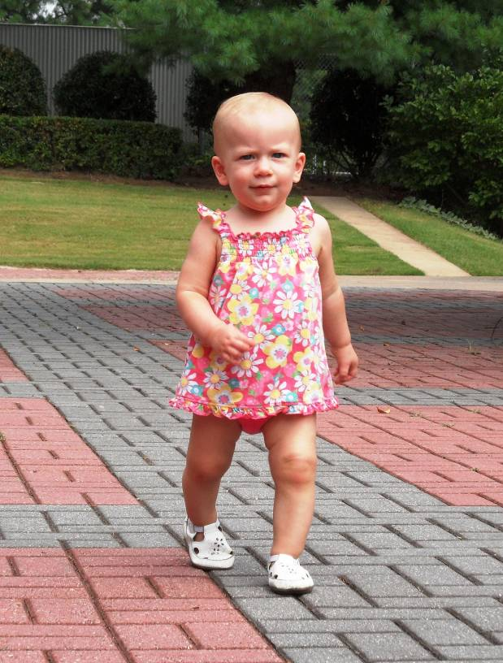
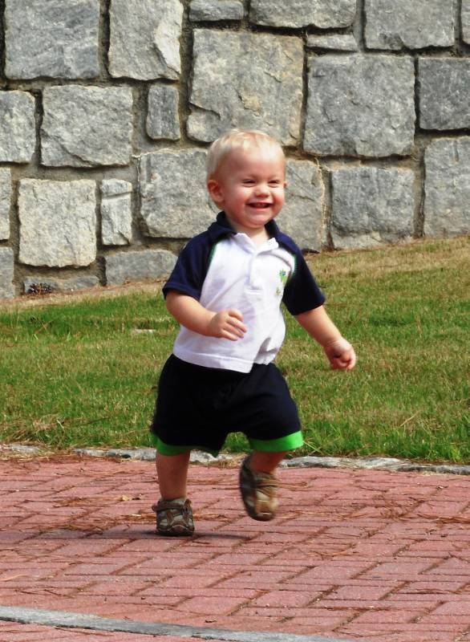
Just Start Walking!
Improve your health and fitness in as little as
20 minutes a day!

Slide 2
Why Walking…
Simple – no instructors or membership needed.
Inexpensive – no special equipment involved.
Achievable – can be done nearly anywhere, anytime.
Easy – just get up and walk!

Slide 3
Benefits of Walking
Improves balance, coordination and spinal health.
Increases aerobic fitness – improves heart and lungs function and aids in weight-loss.
Decreases bone loss.
Improves blood and lymph circulation.
Boosts mood, alertness and energy levels.

Slide 4
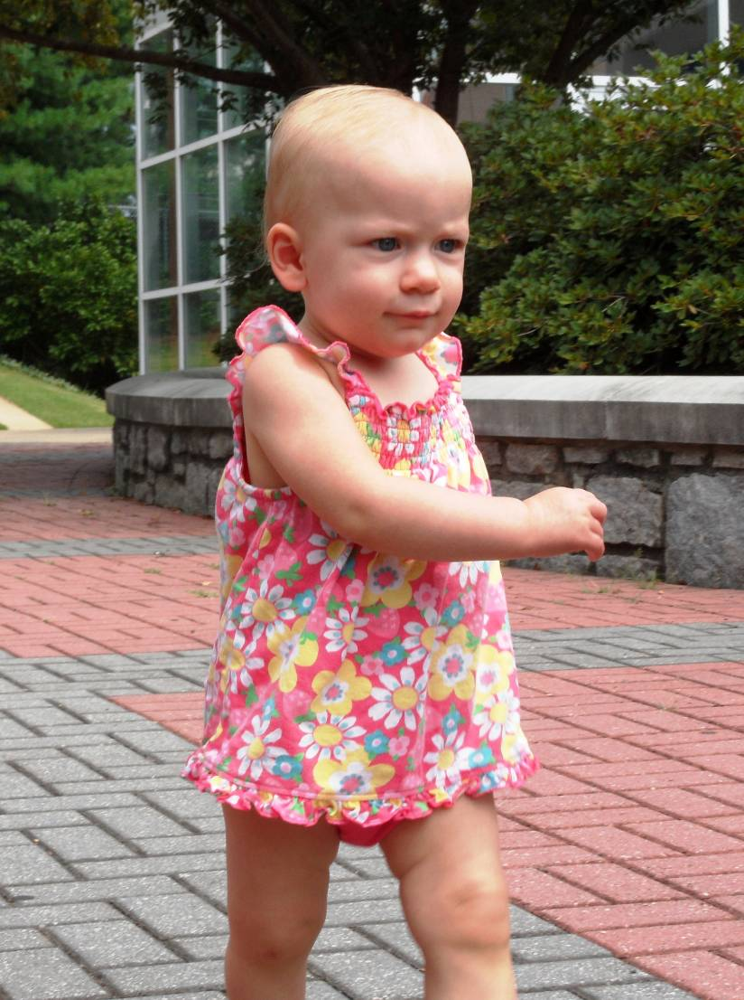
How to Walk
Maintain upright posture throughout - head up and body balanced.
Slightly increase your arm swing
(hand crosses over mid-line of body).
Stride out briskly with relaxed hips.

Slide 5
Directions
Try walking 10 minutes in one direction - turn around, walk 10 minutes back.
You’re done!
If you experience any discomfort, check with your healthcare provider.

Slide 6
Walking Thoughts…
Dress for the weather – consider heat/cold/rain/snow.
Sunshine increases healthful Vitamin D – on long walks clothing helps to prevent overexposure.
Drink enough water before and after you walk.

Slide 7
More Tips…
Wear supportive, shock-absorbing footwear.
Record your time in your wellness exercise diary.
Consider walking with a friend.

Slide 8
Walking with Friends…
A walking partner is a good idea.
It’s more fun and more safe to walk with friends.
Walk your kids to school and back.
Walk and talk with your spouse.

Slide 9
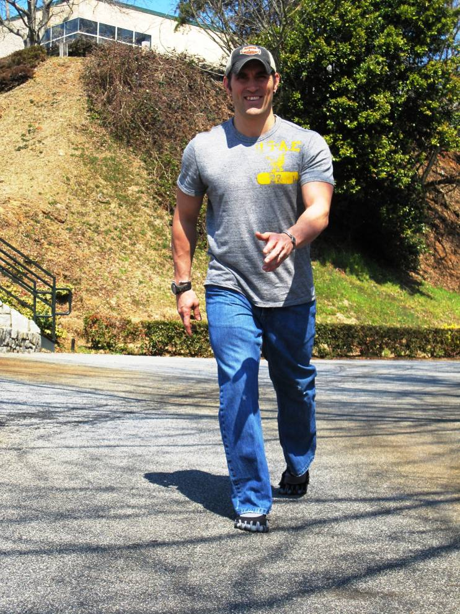
For Further Progress ...
Gradually increase your distance, speed and/or time.
Vary your pace with fast and slow intervals.
Park at the far end of the parking lot.
Use the stairs whenever possible.

Slide 10
For Reinforcement and Relaxation…
Consider a pedometer to count your steps.
A walking contract adds accountability.
Remember to breathe fully and deeply.
Reflect calmly or count your blessings as you walk.

Slide 12
Happy Walking! Enjoy Your Day!

Slide 13
Walking around the World – Send Us Your Pictures
rkirk@life.edu

Slide 14
Selected References
Abenhaim L, Rossignol M, Valat J, et al. The role of activity in the therapeutic management of back pain: report of the International Paris Task Force on Back Pain. Spine. 2000; 25(4S):1S-33S.
Choi BC, Pak AW, Choi JC, Choi EC. Daily step goal of 10,000 steps: a literature review. Clin Invest Med. 2007; 30(3):E146-51.
Gordon PM, Zizzi SJ, Pauline J. Use of a community trail among new and habitual exercisers: a preliminary assessment. Prev Chronic Dis. 2004; 1(4):A11.
Hakim A, Curb JD, Petrovitch H, et al. Effects of walking on coronary heart disease in elderly men: the Honolulu Heart Program, clinical investigation and reports. Circulation. 1999; 100:9-13.
Kramer AF, Erickson KI, Colcombe SJ. Exercise, cognition, and the aging brain. J Appl Physiol. 2006; 101:1237-42.
Lamoth CJ, Meijer OG, Wuisman PI, et al. Pelvis-thorax coordination in the transverse plane during walking in persons with nonspecific low back pain. Spine. 2002; 27(4):E92-9.
Lee IM, Buchner DM. The importance of walking to public health. Medicine & Science in Sports & Exercise. 2008; 40(7):S512-8.
Librett JJ, Yore MM, Schmid TL. Characteristics of physical activity levels among trail users in a U.S. national sample. Am J Prev Med. 2006; 31(5):399-405.
Manson JE, et. al. Walking compared with vigorous exercise for the prevention of cardiovascular events in women. New England Journal of Medicine. 2002; 347(10):716-725.
Penedo FJ, Dahn JR. Exercise and well-being: a review of mental and physical health benefits associated with physical activity. Current Opinion in Psychiatry. 2005; 18(2):189-193.
Weiniger S. Strong walking in: Stand Taller-Live Longer. 2008; BodyZone Press. 202-3. ISBN-10: 0979713609.
Weuve J, Kang JH, Manson JE, et al. Physical activity, including walking, and cognitive function in older women. JAMA. 2004; 292:1454-61.

Slide 15
Serious Walking Power - Kenya

Slide 16
Walking - It’s Fun – Really! Try It!

